Slide 1
Chapter 3: Requirements Determination

Slide 2
Learning Objectives
Learn how to create a requirements definition
Learn various requirements analysis techniques
Learn when to use each requirements analysis techniques
Learn how to gather requirements using interviews, JAD sessions, questionnaires, document analysis & observation
Learn various requirements documentation techniques such as concept maps, story cards & task-lists
Understand when to use each requirements-gathering technique
Be able to begin the creation of a system proposal
Notes:
What phase of the SDLC do we focus on requirements?
What are the key deliverables that are created during the analysis phase?
What is the final deliverable from the analysis phase?
What is in the system proposal?
Who is the prime recipient of the system proposal?

Slide 3
Introduction
The systems development process transforms the existing (as is) system into the proposed (to be) system
Requirements determination
The single most critical step of the entire SDLC
Changes can be made easily in this stage
Most (>50%) system failures are due to problems with requirements
The iterative process of OOSAD is effective because:
Small batches of requirements can be identified and implemented incrementally
The system will evolve over time
Notes:
What is the difference between an “as-is” system and a “to-be” system
Is there a clear line between the Analysis & Design Phases?
What role does object oriented methodologies play in reducing system failures?

Slide 4
Requirements Determination
Purpose: to convert high level business requirements (from the system request) into detailed requirements that can be used as inputs for creating models
What is a requirement?
A statement of what the system must do or a characteristic it must have
Will later evolve into a technical description of how the system will be implemented
Types:
Functional: relates to a process or data
Non-functional: relates to performance or usability
Notes:
What is a requirement?
What is the purpose of the requirements definition report?
What is the most important purpose of the requirements definition document?

Slide 5
Requirements Determination
Purpose: to convert high level business requirements (from the system request) into detailed requirements that can be used as inputs for creating models
What is a requirement?
A statement of what the system must do or a characteristic it must have
Will later evolve into a technical description of how the system will be implemented
Types:
Functional: relates to a process or data
Non-functional: relates to performance or usability
Notes:
How does “Software Quality” relate to functional & non-functional requirements?

Slide 6
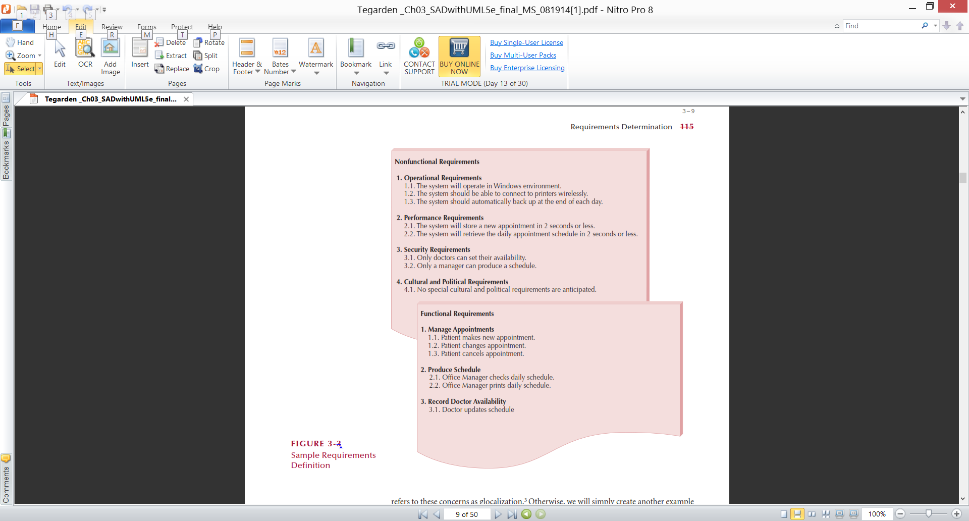
Sample of Requirements Definition
Notes:
What is included in a requirements definition report?
Why is it important to prioritize business requirements?

Slide 7
Determining Requirements
Requirements are best determined by systems analysts and business people together
Techniques for identifying requirements
Interviews, questionnaires and/or observation
Joint application development (JAD)
Document analysis
Notes:
What do we focus on during the analysis process?
What happens if we skip the first step or do it in a cursory manner?
How do you prevent just automating an inefficient system?

Slide 8
Determining Requirements
Business & IT personnel need to collaborate
Strategies for problem analysis:
Root cause analysis
Duration analysis
Activity-based costing
Informal benchmarking
Outcome analysis
Technology analysis
Activity elimination
Notes:
What are some of the things analysts doing during this phase?
What is the best way to handle important “out of scope” requirements?
What are some of the problem areas encountered during this phase?

Slide 9
Requirements Analysis Strategies
Problem analysis
Ask users to identify problems with the current system
Ask users how they would solve these problems
Good for improving efficiency or ease-of-use
Root cause analysis
Focus is on the cause of a problem, not its solution
Create a prioritized list of problems
Try to determine their causes
Once the causes are known, solutions can be developed
Notes:
What must a project team do before they can determine what requirements are appropriate for a given system?
Compare and contrast problem analysis and root cause analysis.
Under what conditions would you use problem analysis?
Under what conditions would you use root cause analysis?

Slide 10
Requirements Analysis Strategies(Cont.)
Duration analysis
Determine the time required to complete each step in a business process
Compare this to the total time required for the entire process
Large differences suggest problems that might be solved by:
Integrating some steps together
Performing some steps simultaneously (in parallel)
Activity-based costing
Same as duration analysis but applied to costs
Informal benchmarking
Analyzes similar processes in other successful organizations
Notes:
What do duration analysis and activity based costing have in common?
What is Duration Analysis?
What is Activity-Based Costing?
What is activity elimination?

Slide 11
Jessica has asked the users to generate a list of problems with the current system and to prioritize the problems in order of importance. Jessica then generated all the possible causes for the problems, starting with the most important. Jessica is identifying improvement opportunities through root cause analysis. T / F

Slide 12
The executive summary is an important component of the system proposal because it is used for convincing the busy executives of the merits of the project as briefly as possible. T / F

Slide 13
Kristin, a systems analyst, needs to know detailed information about the accounts receivable process, but she is not concerned with accounts payable or general ledger, or the integration of this information. Her analysis will assist her in designing a To-Be system for the accounts receivable department. The appropriate requirements-gathering technique to be used would be interviewing. T / F

Slide 14
What do we focus on during the Analysis Phase of the SDLC?

Slide 15
What is the final deliverable from the analysis phase?

Slide 16
What is in the system proposal?

Slide 17
What is the most important purpose of the requirements definition document?

Slide 18
What is included in a requirements definition report?

Slide 19
What do we focus on during the analysis process?

Slide 20
What are some of the problem areas encountered during the analysis phase?

Slide 21
Under what conditions would you use root cause analysis?

Slide 22
Requirements Gathering Techniques
Process is used to:
Uncover all requirements (those uncovered late in the process are more difficult to incorporate)
Build support and trust among users
Which technique(s) to use?
Interviews
Joint Application Development (JAD)
Questionnaires
Document analysis
Observation
Notes:
Describe Observation.
When do we use observation?
Advantages?
Disadvantages?
Questionnaire?
Questionnaires are mass produced and distributed to respondents. Who is their ideal audience?
Advantages?
Disadvantages?

Slide 23
Interviews
Interview - a fact-finding technique whereby the systems analysts collect information from individuals through face-to-face interaction.
Find facts
Verify facts
Clarify facts
Generate enthusiasm
Get the end-user involved
Identify requirements
Solicit ideas and opinions
The personal interview is generally recognized as the most important and most often used fact-finding technique.
Notes:
What is the first step of interviewing?.
How do you determine who should be interviewed?
What skill set is required to conduct effective interviews?
Advantages?
Disadvantages?

Slide 24
Types of Interviews and Questions
Unstructured interview –conducted with only a general goal or subject in mind and with few, if any, specific questions. The interviewer counts on the interviewee to provide a framework and direct the conversation.
Structured interview –interviewer has a specific set of questions to ask of the interviewee.
Open-ended question – question that allows the interviewee to respond in any way.
Closed-ended question – a question that restricts answers to either specific choices or short, direct responses.
Notes:
What are shortfalls of unstructured interviews?
If you are conducting a structured interview and you feel the information you are receiving is not totally accurate, what options do you have?
Give some examples of opened and closed end questions?

Slide 25
Interviewing Do’s
and Don’ts
Avoid
Continuing an interview unnecessarily.
Assuming an answer is finished or leading nowhere.
Revealing verbal and nonverbal clues.
Using jargon
Revealing your personal biases.
Talking instead of listening.
Tape recording -- a sign of poor listening skills.
Do
Be courteous
Listen carefully
Maintain control
Probe
Observe mannerisms and nonverbal communication
Be patient
Keep interviewee at ease
Maintain self-control
Notes:
What do you gain from observing mannerisms and nonverbal communication?
Why do you avoid using jargon?

Slide 26
Prepare for the Interview
Types of Questions to Avoid
Loaded questions
Leading questions
Biased questions
Interview Question Guidelines
Use clear and concise language.
Don’t include your opinion as part of the question.
Avoid long or complex questions.
Avoid threatening questions.
Don’t use “you” when you mean a group of people
Notes:
What are examples of loaded questions?
What are the leading questions?
What are biased questions?
Are questions that criticize, good or bad?

Slide 27
Procedure to Conduct an Interview
Select Interviewees
End users
Learn about individual prior to the interview
Prepare for the Interview
interview guide
Conduct the Interview
Summarize the problem
Offer an incentive for participation
Ask the interviewee for assistance
Follow Up on the Interview
Memo that summarizes the interview
Notes:
The SA’s success is closely tied to his/her interview capability. What are the first things you determine as a SA before actually initiating an interview?
How long should interviews be?

Slide 28
Interviewing Strategies
Top-down
How
can order
processing be
improved?
High-level:
Very general
Medium-level:
Moderately specific
How can we reduce the
number of times that customers
return ordered items?
Low-level:
Very specific
How can we reduce the number of
errors in order processing (e.g., shipping
the wrong products)?
Bottom-up
Notes:
What is the first goal of an interview?
Is note taking important?
How do you close an interview?
Contrast Unstructured & Structured interviews.

Slide 29
Joint Application Development (JAD)
a process whereby highly structured group meetings are conducted for the purpose of analyzing problems and defining requirements.
Notes:
What problem does JAD sessions solve that typically occur when we conduct separate interviews?
Are JAD sessions relatively easy to conduct?
Each JAP session includes a variety of participants, each of whom is expected to actively reinforce their roles throughout the session Who is the sponsor and what is his role?
Role of the facilitator?
Users?
Managers?
Scribes?
IT staff?

Slide 30
Steps to Plan a JAD Session
Selecting a location
Away from workplace when possible
Requires several rooms
Equipped with tables, chairs, whiteboard, overhead projectors
Needed computer equipment
Selecting the participants
Each needs release from regular duties
Preparing the agenda
Briefing documentation
Agenda distributed before each session
Notes:
JAD sessions require a great deal of planning. What are some things that must be decided before the session is initiated?
Why off-site?
Why hire a JAD qualified facilitator?
What are some things that the agenda might include?

Slide 31
Guidelines for Conducting a JAD Session
Do not unreasonably deviate from the agenda
Stay on schedule
Ensure that the scribe is able to take notes
Avoid the use of technical jargon
Apply conflict resolution skills
Allow for ample breaks
Encourage group consensus
Encourage user and management participation without allowing individuals to dominate the session
Make sure that attendees abide by the established ground rules for the session
Notes:
JAD have agendas published in advance. Why?
What are some of the issues / concerns associated with JAD sessions?

Slide 32
Brainstorming
Sometimes, one of the goals of a JAD session is to generate possible ideas to solve a problem.
Brainstorming is a common approach that is used for this purpose.
Brainstorming – a technique for generating ideas by encouraging participants to offer as many ideas as possible in a short period of time without any analysis until all the ideas have been exhausted.
Notes:
Who can describe brain storming without using the phrases on this slide?

Slide 33
Brainstorming Guidelines
Isolate appropriate people in a place that free from distractions and interruptions.
Make sure everyone understands purpose of the meeting.
Appoint one person to record ideas.
Remind everyone of brainstorming rules.
Within a specified time period, team members call out their ideas as quickly as they can think of them.
After group has run out of ideas and all ideas have been recorded, then and only then should ideas be evaluated.
Refine, combine, and improve ideas generated earlier.
Notes:
What are the rules of brainstorming?

Slide 34
Benefits of JAD
JAD actively involves users and management in the development project (encouraging them to take “ownership” in the project).
JAD reduces the amount of time required to develop systems.
When JAD incorporates prototyping as a means for confirming requirements and obtaining design approvals, the benefits of prototyping are realized
Notes:
JAD is becoming more popular as companies understand its benefits and incorporate it into its methodology. Why does JAD reduce the amount of time required to develop systems?
What is the difference between calendar time and person hours?

Slide 35
Questionnaire Steps
Select the participants
Identify the population
Use representative samples for large populations
Designing the questionnaire
Careful question selection
Remove ambiguities
Administering the questionnaire
Working to get good response rate
Offer an incentive (e.g., a free pen)
Questionnaire follow-up
Send results to participants
Send a thank-you
Notes:
What are typical response rates for questionnaires?
How can you improve response rates for questionnaires?.

Slide 36
Good Questionnaire Design
Begin with non-threatening and interesting questions
Group items into logically coherent sections
No important items at the very end
Do not crowd a page with too many items
Avoid abbreviations
Avoid biased or suggestive items or terms
Number questions to avoid confusion
Pretest to identify confusing questions
Provide anonymity to respondents
Notes:
How does designing questions for questionnaires differ from designing questions for interviews or JAD sessions?
What must be decided on before a questionnaire is distributed?

Slide 37
What are the advantages of personal interviews?

Slide 38
What are shortfalls of unstructured interviews?

Slide 39
Each JAD session includes a variety of participants, each of whom is expected to actively reinforce their roles throughout the session Who is the sponsor and what is his role ?

Slide 40
Questionnaires are mass produced and distributed to respondents. Who is their ideal audience?

Slide 41
When do we use observation as a fact finding technique?

Slide 42
Who is a JAD sponsor and what is the sponsor’s role?

Slide 43
Identify and briefly describe the two types of questionnaires.

Slide 44
What are the three rules of brainstorming?

Slide 45
Document Analysis
Provides information about the “as-is” system
Review technical documents when available
Review typical user documents:
Forms
Reports
Policy manuals
Look for user additions to forms
Look for unused form elements
Notes:
What is document analysis?
What is an informal system?

Slide 46
Sampling Existing Documentation, Forms, & Files
Sampling –process of collecting a representative sample of documents, forms, and records.
Organization chart
Memos and other documents that describe the problem
Standard operating procedures for current system
Completed forms
Manual and computerized screens and reports
Samples of databases
Flowcharts and other system documentation
And more
Notes:
What can you say about documentation in general?
What does representative mean?

Slide 47
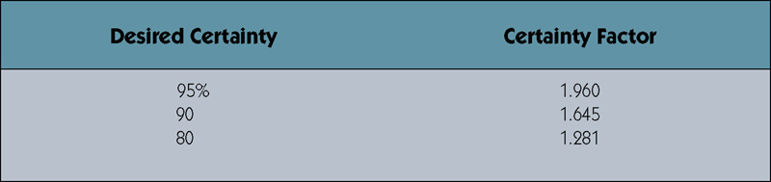
Determining Sample Size for Forms
Sample Size = 0.25 x (Certainty factor/Acceptable error) ²
Sample Size = 0.25(1.645/0.10) ² = 68
Sample Size =0.10(1 – 0.10)(1.645/0.10)² = 25
Or if analyst knows 1 in 10 varies from norm.
Certainty factor from certainty table. 10% acceptable error.
Notes:
This slide depicts two formulas to determine sample size. How do we ensure the information we derive from our samples are representative?
In the first example, if I sample 68 purchase orders and determine from this sample that the average order size is three hundred dollars, how do I describe what that $300 means?

Slide 48
Sampling Techniques
Randomization – a sampling technique characterized by having no predetermined pattern or plan for selecting sample data.
Stratification – a systematic sampling technique that attempts to reduce the variance of the estimates by spreading out the sampling—for example, choosing documents or records by formula—and by avoiding very high or low estimates.
Notes:
How do we choose our 68 samples?
If I have 250,000 computer records and I want to sample 25 via a systematic formula, how would I do it?

Slide 49
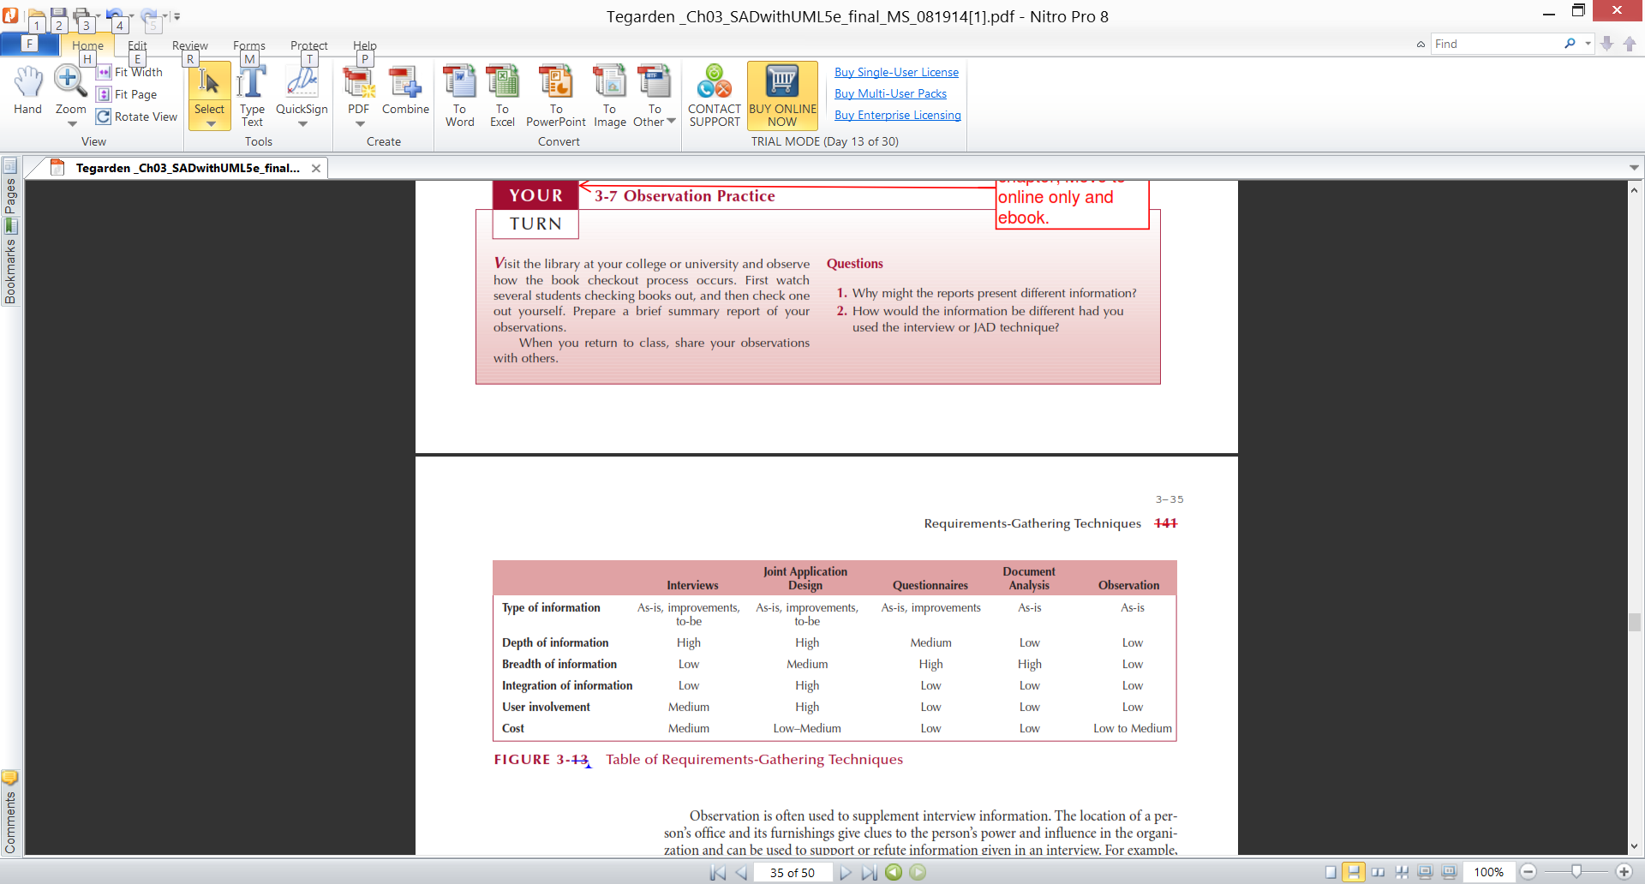
Requirements-Gathering Techniques Compared
A combination of techniques may be used
Document analysis & observation require little training; JAD sessions can be very challenging
Notes:
How do you to select an information-gathering techniques?
What the most productive information gathering methods?

Slide 50
Alternative Techniques
Concept Maps
Represent meaningful relationships between concepts
Focus individuals on a small number of key ideas
Notes:
What is the primary advantage of concept maps?
What are the disadvantage of concept maps?

Slide 51
Story Cards & Task Lists
Capture requirement using story cards (index cards)
File card with single requirement
Each requirement (card) is discussed
How much effort is required to implement it
A task list is created for each requirement (story)
Large requirements can be split into smaller sections
The story can be prioritized by risk level and importance
Notes:
What are some of the advantages of using story cards and task lists as a requirements gathering and documentation technique?

Slide 52
The System Proposal
Combines all material created in planning & analysis
Included sections:
Executive summary
Provides all critical information is summary form
Helps busy executives determine which sections they need to read in more detail
The system request
The workplan
The feasibility analysis
The requirements definition
Current models of the system (expected to evolve)
Notes:
What information is typically included in a system proposal?
What is an executive summary and what is its the purpose?

Slide 53
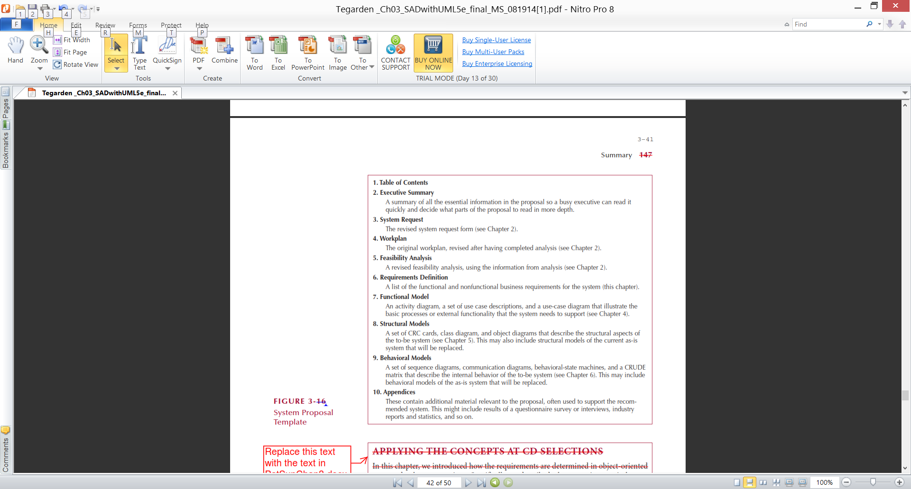
System Proposal Template
Notes:
Here is a sample System Proposal

Slide 54
Define Requirements Validation.

Slide 55
What is Requirements Traceability?

Slide 56
Briefly describe the information is typically included in a system proposal?

Slide 57
Compare functional requirements and nonfunctional requirements

Slide 58
Explain the meaning of the statement: “To hear is to recognize that someone is speaking, to listen is to understand what the speaker wants to communicate.”

Slide 59
What is work sampling?

Slide 60
Mini Case
Read Class Handout

Slide 61
What is the purpose of Eddie’s interview with the dean? What are some of the topics he should cover? What is an example of a good close-ended question he can ask? What is an example of a good open-ended question he can ask? What is an example of a good range of response question he can ask?

Slide 62
What is the purpose of Eddie’s interview with the dean?

Slide 63
What are some of the topics he should cover?

Slide 64
What is an example of a good close-ended question he can ask?

Slide 65
What is an example of a good open-ended question he can ask?

Slide 66
What is an example of a good range of response question he can ask?

Slide 67
Mini Case
Read Mini Case
#1 Page #116

Slide 68
What requirements analysis strategy or strategies would you recommend for this situation?

Slide 69
Mini Case
Read Mini Case
#2 Page #117

Slide 70
What do you suggest Brian tell Joe?

Slide 71
Mini Case
Read Mini Case
#4 Page #118

Slide 72
What suggestions do you have that could have improved Anne’s response rate to the questionnaire?

Slide 73
_______ is an example of functional requirements.
a. The system should work with any web browser
b. The system should load any web page within 3 seconds
c. Customers should be able to see their orders after authentication
d. The system should comply with the company’s policy of buying all PCs and servers from Dell
e. The system should be able to search all available inventory in order to determine whether a product can be made by a given date

Slide 74
The goal of ______ analysis strategy is to make minor or moderate changes to the business processes so that they will become more efficient and effective.
a. business process automation
b. business process benchmarking
c. business process improvement
d. business process reengineering
e. business process systemization

Slide 75
Sarah would like to give the interviewee more control over the interview and to gather rich information. She should ask _____ questions.
a. closed-ended
b. inappropriate
c. open-ended
d. opinion
e. probing

Slide 76
The functional model component of the system proposal includes _______.
a. a activity diagram
b. a set of use case descriptions
c. a use case diagram
d. all of these
e. none of these

Slide 77
The ___________ requirements are associated with the efficiency, maintainability, portability, reliability, reusability, testability, and usability quality dimensions..
a. functional
b. non-functional
c. standard
d. correctness
e. performance

Slide 78
The three fundamentally different strategies for the analysis phase (business process automation, business process improvement, and business process reengineering) are stand-alone strategies and should not be combined in the analysis process.
T / F

Slide 79
When you begin an interview, the first goal is to establish control and let the interviewee know that you have a mastery of the subject. T / F

Slide 80
What are the three types of interview questions? Define and identify why an analyst would use each type of question. Include an example of each question type.

Slide 81
Briefly describe document analysis.

Slide 82
Briefly describe
Observation.

Slide 83
What are the advantages and disadvantages of document analysis?

Slide 84
What are the advantages and disadvantages observation?

Slide 85
What two techniques are best suited for gathering information during all three stages of the information-gathering process (As-Is, improvements, and To-Be)? Discuss the user involvement and cost, as well as the depth, breadth, and integration of information for each.

Slide 86
Briefly describe the Story Cards and Task Lists requirements documentation techniques. What are some of the advantages of using story cards and task lists as a requirements gathering and documentation technique?

Slide 87
Briefly explain the non-functional requirements and functional requirements in software quality.

Slide 88
Is there a clear line between the Analysis & Design Phases?

Slide 89
What role does object oriented methodologies play in reducing system failures?

Slide 90
What is a requirement?

Slide 91
How does “Software Quality” relate to functional & non functional requirements?

Slide 92
Why is it important to prioritize business requirements?

Slide 93
How do you prevent just automating an inefficient system?

Slide 94
What must a project team do before they can determine what requirements are appropriate for a given system?

Slide 95
What is activity elimination?

Slide 96
What is the first step of interviewing?

Slide 97
How do you determine who should be interviewed?

Slide 98
What is the first goal of an interview?

Slide 99
Is note taking important?

Slide 100
How do you close an interview?

Slide 101
What are some of the issues / concerns associated with JAD sessions?

Slide 102
How are participants chosen for JAD sessions?

Slide 103
What must be decided on before a questionnaire is distributed?

Slide 104
What is an informal system?

